Slide 1

NETWORK DEVICES
By- Ninaada.p.l
Shama.S
Shikha
Deepak

Slide 2
Modulation
Modulation is the process of conversion
of binary signal/digital signal to analog signal
Three types of modulation techniques
1.AM (Amplitude Modulation)
2.FM (Frequency Modulation)
3.PM (Phase Modulation)

Slide 3
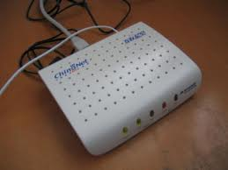
Modem
A modem is a computer peripheral that
allows us to connect
and communicate with other computers
via
telephone lines.
In other words, Modem (Modulator-Demodulator)
is a communication device
that converts binary signal into analog signals (Modulation)
for transmission over the telephone lines and converts
these analog signals back into binary form ( Demodulation)
at the receiving end.

Slide 4
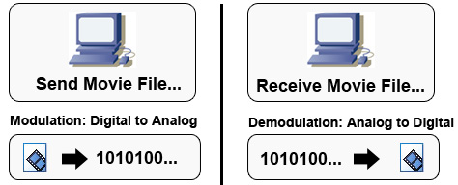
WORKING OF MODEM
MODEM
DCE
MODEM
DCE
DTE
TELEPHONE LINES
DTE

Slide 5
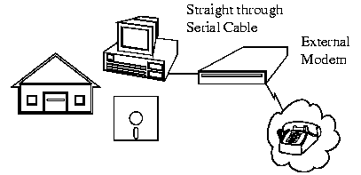
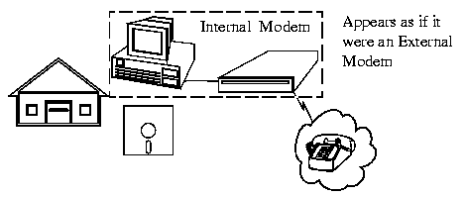
TWO BASIC PHYSICAL TYPES OF MODEM:
1. INTERNAL MODEM:
2. EXTERNAL MODEM:
Modems that are fixed within the computers. The advantage of an internal modem is the lack of extra wires required for installation. Internal modems get their power from the computer's power supply.
Modems connected externally to the computer. External modems require a power source and extra wires to connect to the computer. The advantage of external modems is that they feature lights on the front so you can monitor the connection status. Internal modems cannot be viewed from outside the computer except in the back of the unit.

Slide 6
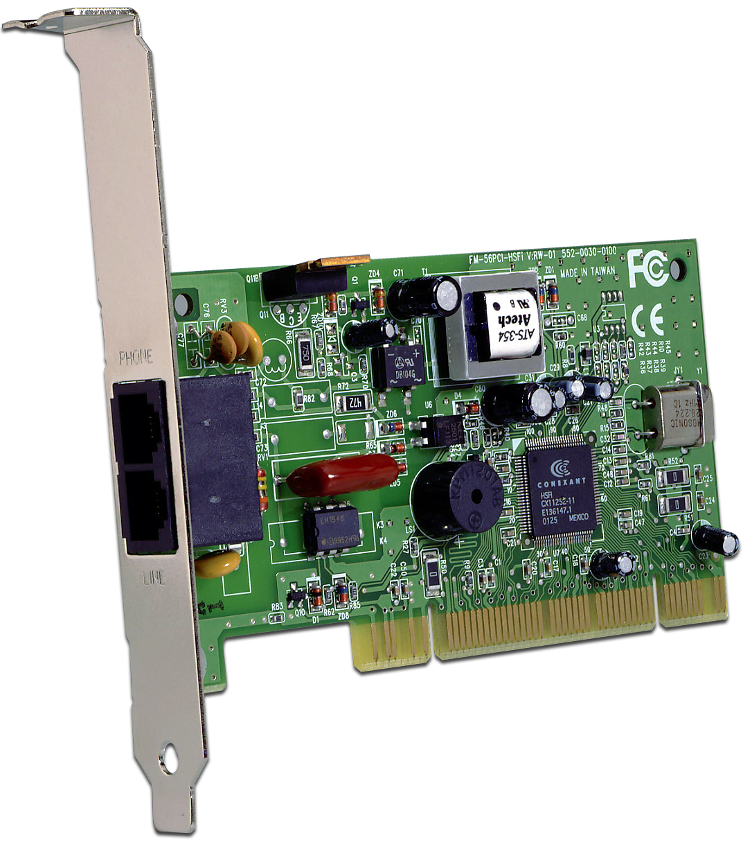

Slide 7
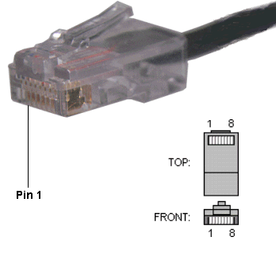
RJ-45 CONNECTOR
RJ-45 stands for Registered Jack- 45. It is an eight wire connector which is commonly used to connect computers on local area networks i.e. LAN.
RJ-45 Connector is much
wider than RJ-11 as it
houses 8 wires instead of four

Slide 8
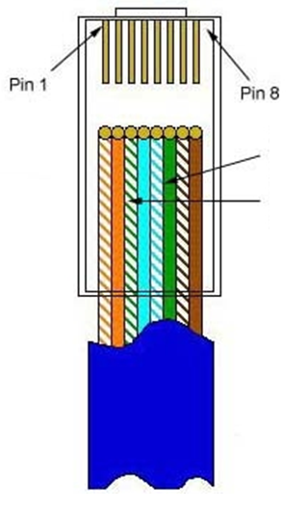

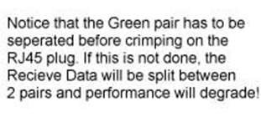
.

Slide 9
ETHERNET :
Ethernet is the dominant cabling and low level data delivery technology used in Local Area Networks (LAN’s).
It was developed by Xerox corp. along with DEC and Intel.
Features:
Ethernet transmits data up to ten million bits per second.
Ethernet supports networks built with twisted pair, thin and thick coaxial and fiber optic cabling.
Each device on an Ethernet network operates independently and equally, precluding the need for a central controlling device.
Ethernet supports a wide array of data types, including TCP/IP, ,apple talk, and IPX.
To prevent the loss of data, when two or more devices attempt to send packets at the same time, Ethernet detects collisions.

Slide 10
ETHERNET CARD
(NETWORK INTERFACE CARD)
A network interface card is a piece of computer hardware designed to allow computers to communicate over a computer network.
The computers that are part of Ethernet have to install a special card called Ethernet Card.
An Ethernet supports three types of connections:
RJ-45 connection, if it is designed for twisted pair
BNC Connector, if it is designed for coaxial cable
AUI connector

Slide 11
HUB
A Hub is a hardware device used to connect several
computers together. A hub contains multiple ports.
FUNCTIONING OF A HUB:
Hubs forward any data packets – including e-mail, word documents, spreadsheets, graphics- they receive over one port to all of the remaining ports. All users connected to a single hub are in the same segment.
Hubs are either Passive or Active.
ACTIVE HUBS:
Electrically amplifies the signal as it moves from one connected device to the other.
PASSIVE HUBS:
Allows the signal to pass from one computer to another without any change.

Slide 12
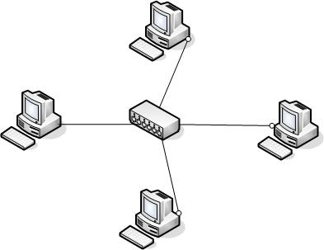
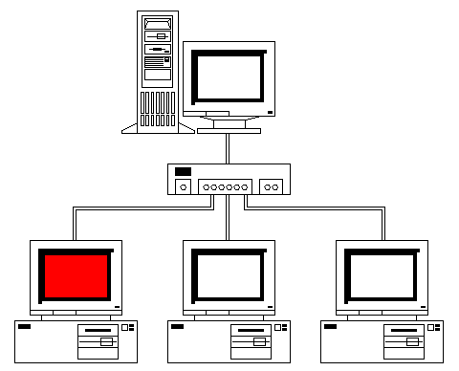

Slide 13
Networking Devices
Repeaters
Hubs
Collisions
Bridges
Routers

Slide 14

SWITCH
A switch is a device that is used to segment networks into subnetworks called subnets.
Allow different nodes of a network to communicate directly with each other.
Allow several users to send information over a network at the same time without slowing each other down.
Responsible for filtering-transforms data in a specific way and for forwarding packets between LAN segments.

Slide 15
REPEATER:
What internetworking devices operate at the physical layer (layer 1) of the OSI model?
When signals first leave a transmitting station, they are clean and easily recognizable. However, the longer the cable length, the weaker and more deteriorated the signals become as they pass along the networking media.
Repeaters can be installed along the way to ensure that data packets reach destination

Slide 16
What is the disadvantage associated with using a repeater?
it can't filter network traffic. Data, sometimes referred to as bits, arriving at one port of a repeater gets sent out on all other ports
data gets passed along by a repeater to all other LAN segments of a network regardless of whether it needs to go there or not.

Slide 17
What internetworking device can be used to filter traffic on the network?
One way to solve the problems of too much traffic on a network and too many collisions is to use an internetworking device called a bridge.
A bridge eliminates unnecessary traffic and minimizes the chances of collisions occurring on a network by dividing it into segments

Slide 18
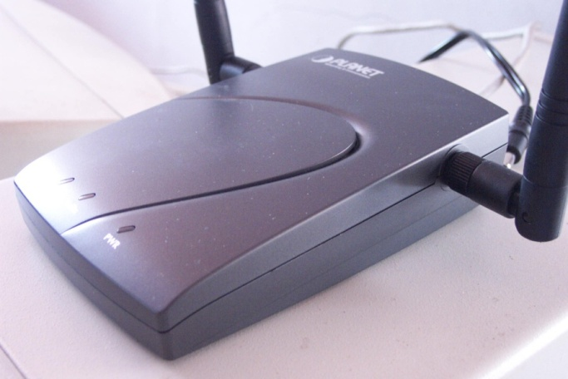
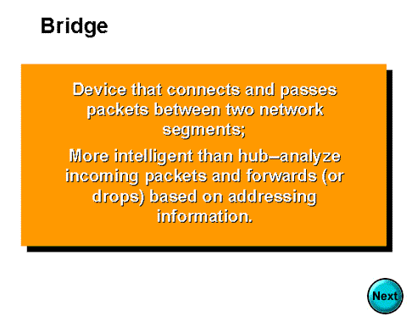

Slide 19
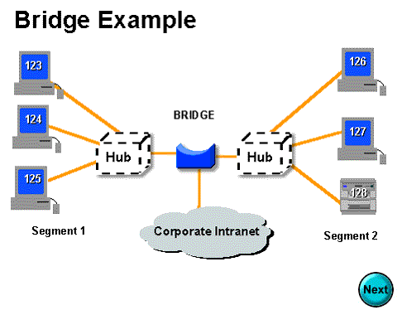

Slide 20
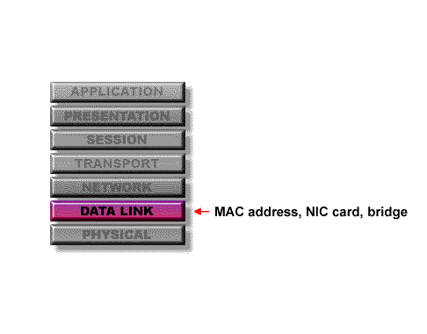
At what layer of the OSI model do bridges operate?
Because bridges operate at the data link layer, layer 2, they are not required to examine upper-layer information.

Slide 21
How are bridge data-forwarding decisions limited?
Although bridges use tables to determine whether or not to forward data to other segments of the network, the types of comparisons and decisions they make are relatively low level, simple ones

Slide 22
What types of network traffic problems is a bridge incapable of solving?
Bridges work best where traffic from one segment of a network to other segments is not too great.
However, when traffic between network segments becomes too heavy, the bridge can become a bottleneck and actually slow down communication.

Slide 23

What are routers?
Routers are another type of internetworking device.
These devices pass data packets between networks based on network protocol or layer 3 information.
Routers have the ability to make intelligent decisions as to the best path for delivery of data on the network.

Slide 24
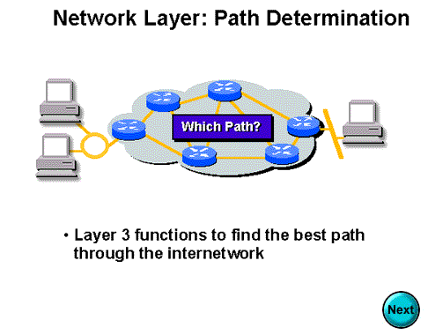

Slide 25
What network problems can routers help resolve?
The problem of excessive broadcast traffic can be solved by using a router.
Routers are able to do this, because they do not forward broadcast frames unless specifically told to do so

Slide 26
How do routers differ from bridges?
Routers differ from bridges in several respects. First, bridging occurs at the data link layer or layer 2,while routing occurs at the network layer or layer 3 of the OSI model.
Second, bridges use physical or MAC addresses to make data forwarding decisions. Routers use a different addressing scheme that occurs at layer three

Slide 27
How do routers work?
Routers are used to connect two or more networks. For routing to be successful, each network must have a unique network number

Slide 28
gatewaY
Device that connects dissimilar networks.
Operates at the highest level of
abstraction.
Expands the functionality of routers by
performing data translation and
protocol conversion.
Needed to convert Ethernet traffic from
LAN to San(Systems Network
Architecture)traffic legacy system.
Then routes the SNA traffic to the
mainframe.
When Mainframe answers, Reverse
process occurs.
Establishes an intelligent connection between a
local network and external networks with
completely different structures.

Slide 29
Types OF Network
There are 3 types of Network:
Local Area Networks(LANs)
Metropolitan Area Networks(MANs)
Wide Area Networks(WANs)

Slide 30
General Network Design Process
In general ,the network design problems consists of the following 3 general elements:
Environmental given: Includes the locations of hosts, servers, terminals and other nodes
Performance constraints: Consists of network reliability, traffic throughput and host/client computer speeds
Internetworking variables: Includes the network topology, line capacities, and packet flow assignments

Slide 31
General Network Design Process
Access needs and costs
Select topologies and technologies to satisfy needs
Model network workload
Simulate behaviour under expected load
Perform sensitivity tests
Rework design as needed

Slide 32
Good Network Design Process
The 80-20 Rule
In a properly designed small to medium sized network environment,80% of the traffic on a given network segment is local and not more than 20 % of the network traffic should need to move across a backbone.

Slide 33

LAN Hardware
The section covers the following hardware hardware technologies as they can be applied to LAN design:
Repeaters
Hubs
Bridges
Switches
Routers
Combining hubs , switches, and routers

Slide 34
Repeaters
5-4-3 Rule
The maximum path between 2 stations on the network should not be more than 5 segments with 4 repeaters between those segments and no more than 3 populated segments.
Repeaters
Host A
Host Z

Slide 35

Bridges
Bridges are used to connect separate segments of a network.
Bridges implement the Spanning-Tree Protocol to build a loop free network topology. This means that on a network ,one or more bridges may be blocked if they are forming a loop . Bridges communicate with each other, exchanging information such as priority and bridge interface MAC address. They select a root bridge and then implement the Spanning-Tree Protocol.
Blocking
x
Bridges
Blocking
x

Slide 36
Problem With Hubs
Hubs share Bandwidth among all attached devices. Hubs cannot filter traffic. They broadcast data to all devices
Solution
The solution is to use a smarter bridge called BRIDGE. Bridges can filter network traffic based on MAC.

Slide 37
Problem with a Switch
A switch cannot stop traffic (data packets) destined for a different LAN segment from travelling to all other LAN segments.
Solution
The solution is to use a ROUTER. The Routers filter network traffic based on IP address. The IP address tells the Router which LAN segment the network traffic belongs to.

